Slide 1
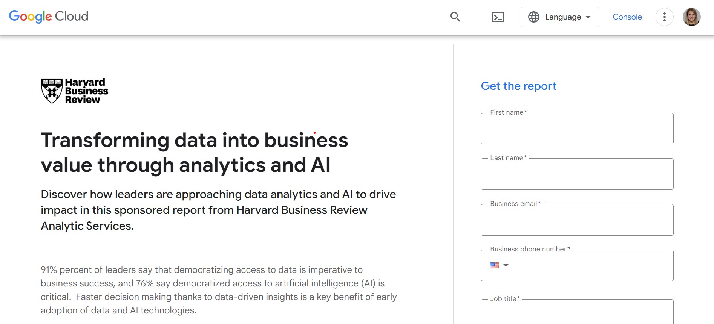
HBR Analytic Services Report Promotion
Sponsor must use “Harvard Business Review Analytic Services” when referencing the report creator (all five words, no abbreviations).
The sponsor’s role in the research project must be referenced as “sponsor” or “Harvard Business Review Analytic Services in association with SPONSOR”. Cannot say “in partnership.”
Sponsor must send HBR-AS press/promotional/marketing materials referencing the report for approval.
Sponsor must use the Harvard Business Review logo, not the HBR Analytic Services logo
When using the HBR logo, the sponsor must be the lead logo and must be 25% larger than the HBR logo.
In marketing materials HBR’s logo cannot be placed directly next to the sponsor logo (lockup style)
Alex Clemente, Managing Director of Analytic Services, is available for press quotes related to the Harvard Business Review Analytic Services report (example here).
Quotes from HBR-provided/recommended interviewees are allowed for use in the report ONLY and cannot be used within press or promotional content. Sponsor may seek direct approval from their client/customer interviewees for use of their quotes in promotional/press purposes
Promotion Parameters

Slide 2
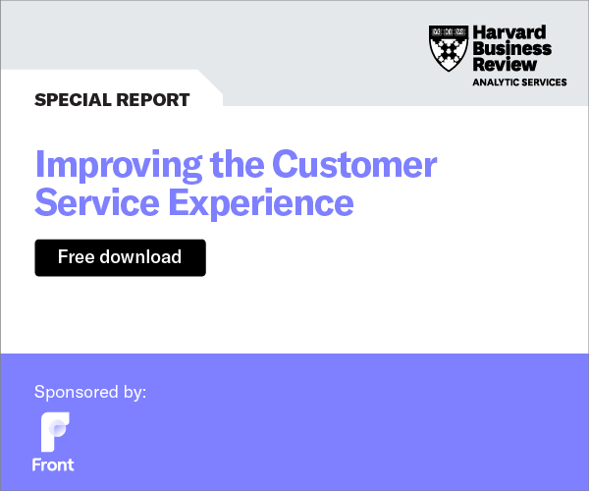
HBR Analytic Services Co-branded Ads
HBR-AS will promote the report via co-branded drivers, which run in remnant inventory on HBR.org.
Banners will direct to an HBR.org-hosted PDF of the report or a client hosted-page of the report PDF.
Report will be posted on https://hbr.org/hbr-analytic-services
Examples

Slide 3
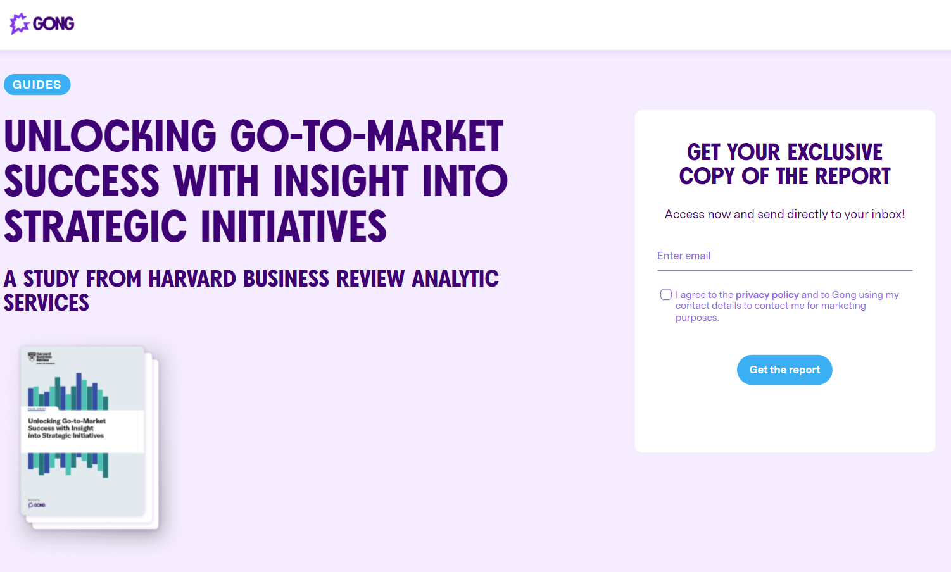
HBR Analytic Services Report Promotion
Promotion Example

Slide 4
